Slide 1
Chemical Solubility Prediction - A Machine Learning Way
DA 5030 Final Project
Jiaming Xu
May 3rd, 2022

Slide 2
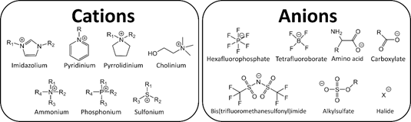
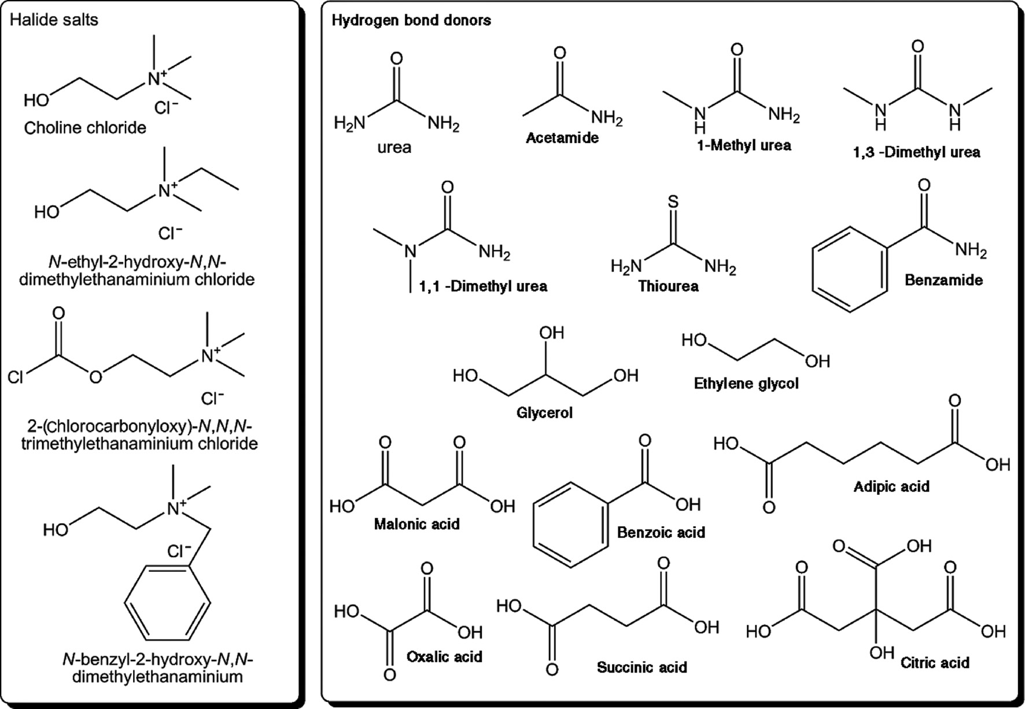
Ionic Liquids (Ils)
Why using ML for solubility prediction?
Deep Eutectic Solvents (DESs)
Good future for IL and DES
Millions of possible structures
Limitation of labor and computational power.
INTERNET Database of Periodic Tables | Chemogenesis (meta-synthesis.com)
Machine Learning : qu'est-ce que c'est, et pourquoi ça change le monde (datascientest.com)

Slide 3
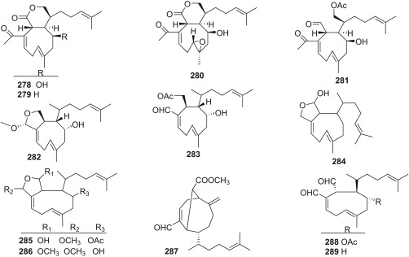
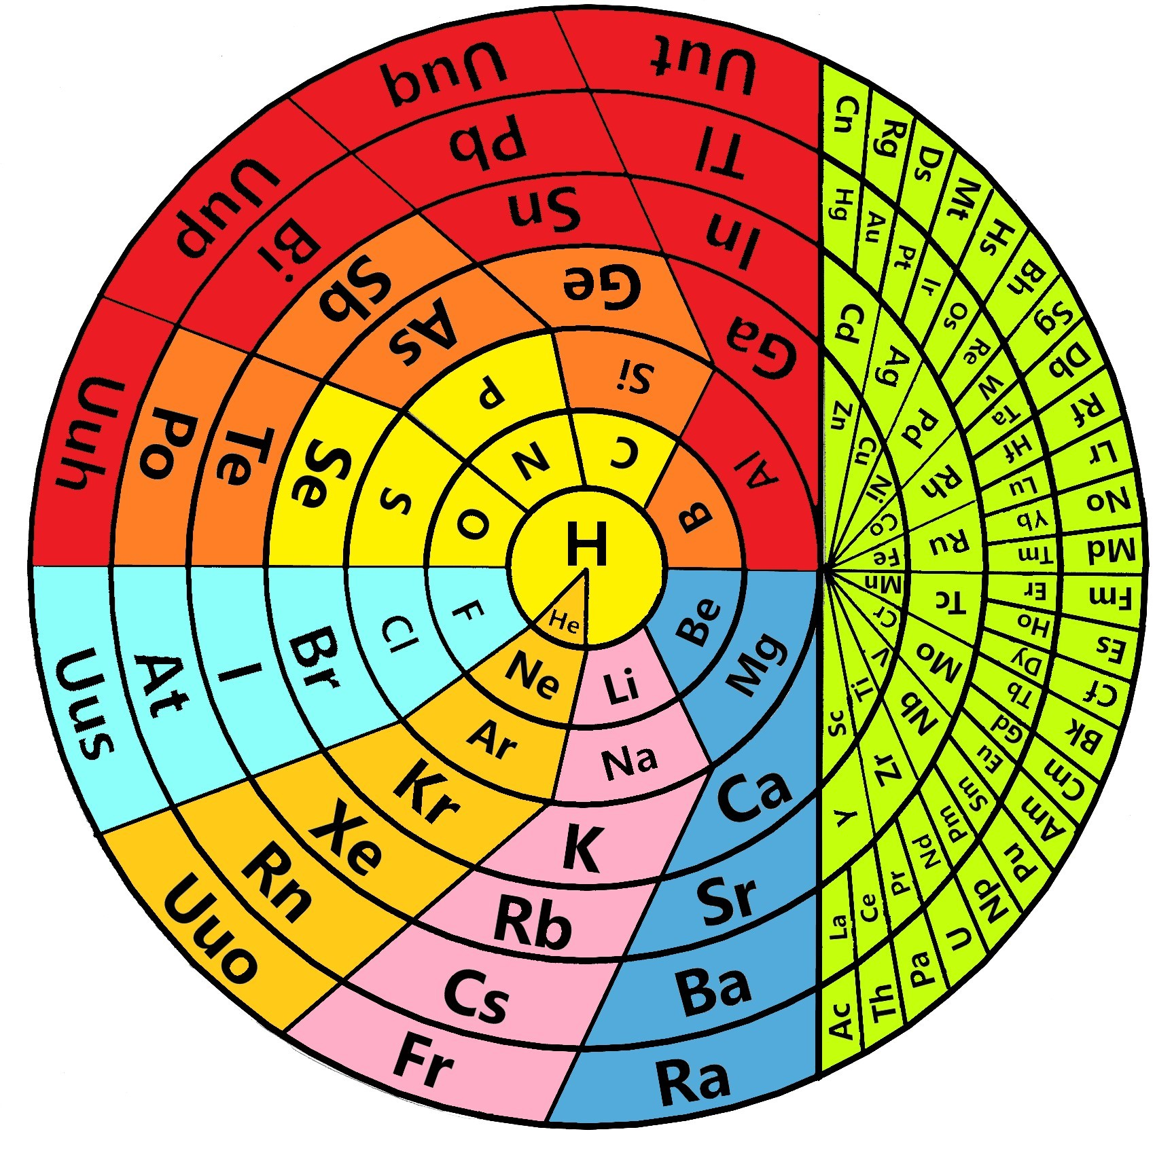
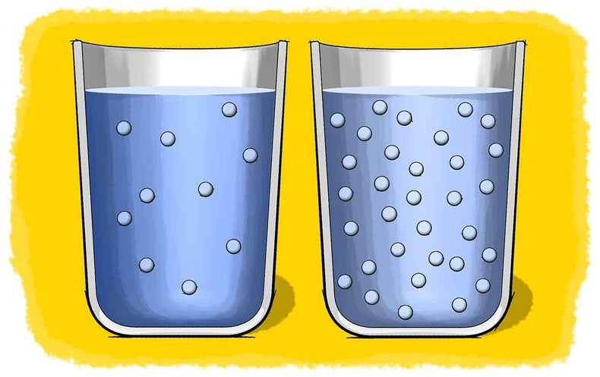
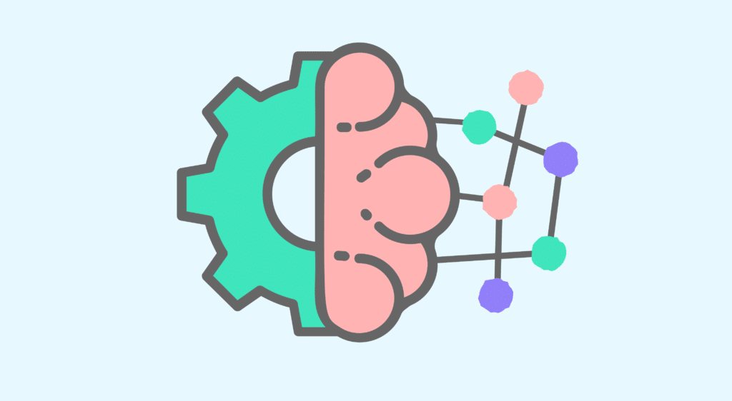
Basic Approach
Molecules
Atoms
Solubility in water.
INTERNET Database of Periodic Tables | Chemogenesis (meta-synthesis.com)
Machine Learning : qu'est-ce que c'est, et pourquoi ça change le monde (datascientest.com)
Machine Learning

Slide 4
SMILEs structure
(ClCC(Cl)(Cl)Cl)
Data Collection
PUG REST API
https://pubchem.ncbi.nlm.nih.gov/rest/
pug/compound/smiles/SMILES/record/JSON
fromJSON
query
PUBCHEM
R
fromJSON
return
JSON
INTERNET Database of Periodic Tables | Chemogenesis (meta-synthesis.com)
Machine Learning : qu'est-ce que c'est, et pourquoi ça change le monde (datascientest.com)

Slide 5
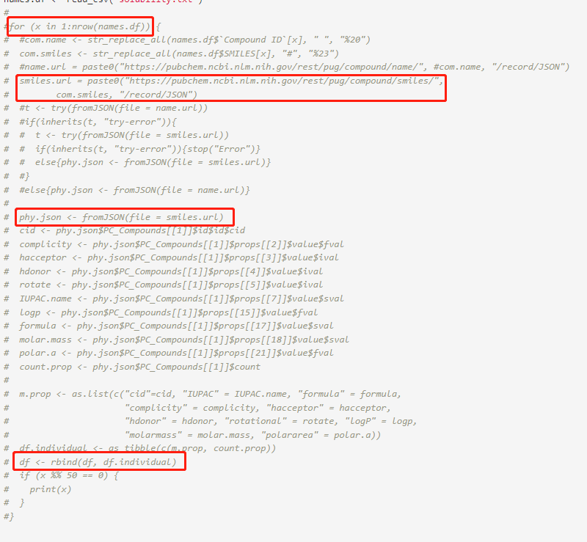
Data Collection
R

Slide 6
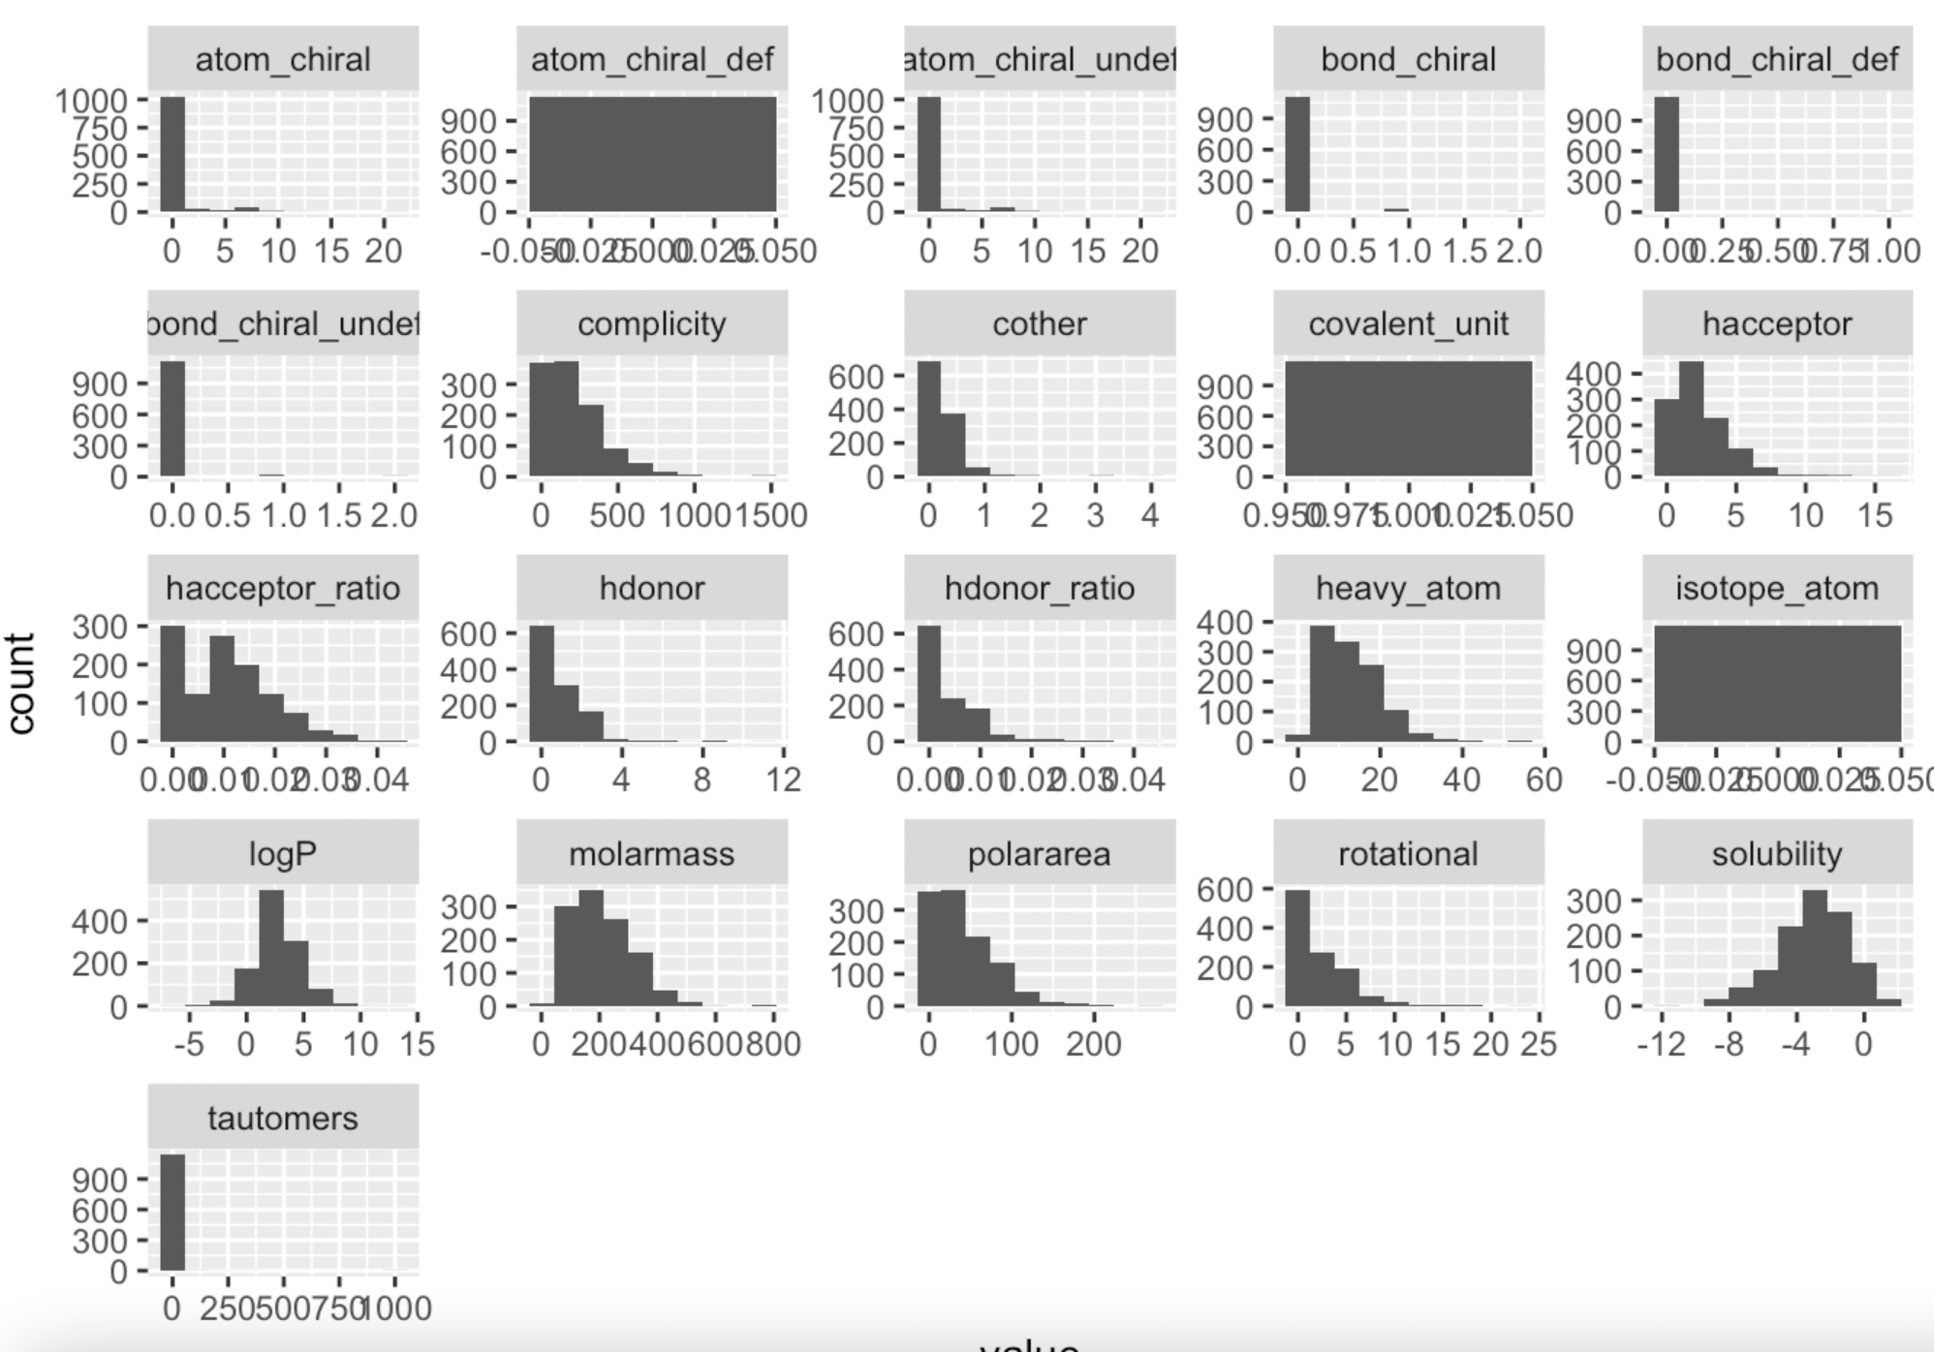
Data Exploration
[1] “cid” [2] “IUPAC” [3] “formula” [4] “complicity” [5] “hacceptor” [6] “hdonor” [7] “rotational” [8] “logP” [9] “molarmass” [10] “polararea” [11] “heavy_atom” [12] “atom_chiral” [13] “atom_chiral_def” [14] “atom_chiral_undef” [15] “bond_chiral” [16] “bond_chiral_def” [17] “bond_chiral_undef” [18] “isotope_atom” [19] “covalent_unit” [20] “tautomers”

Slide 7
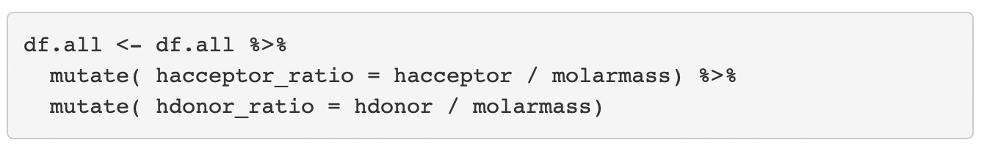
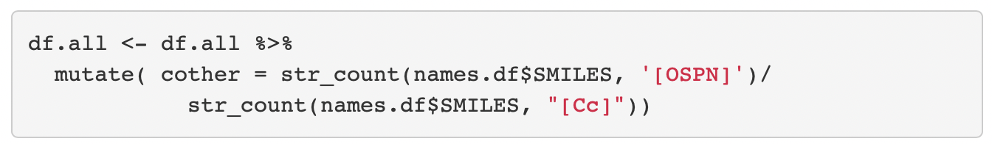
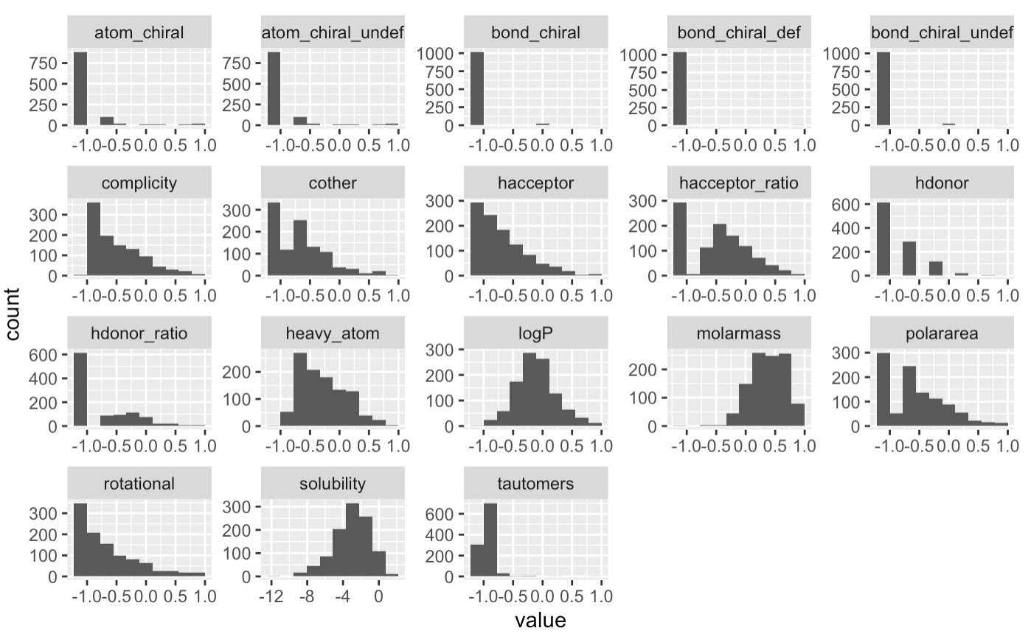
Rescale and Feature Engineering

Slide 8
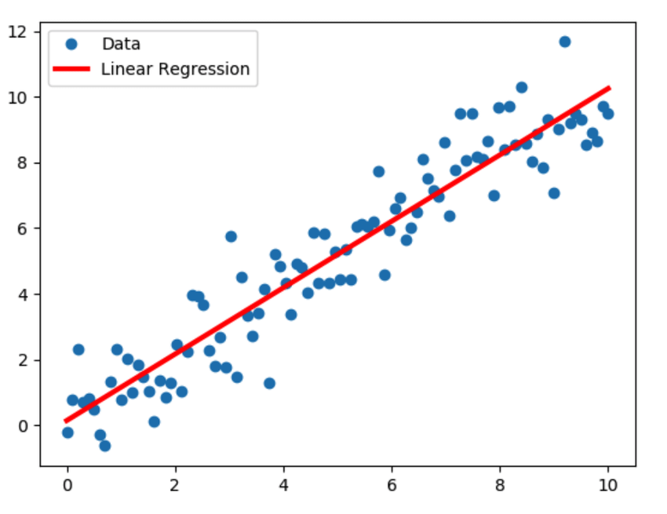
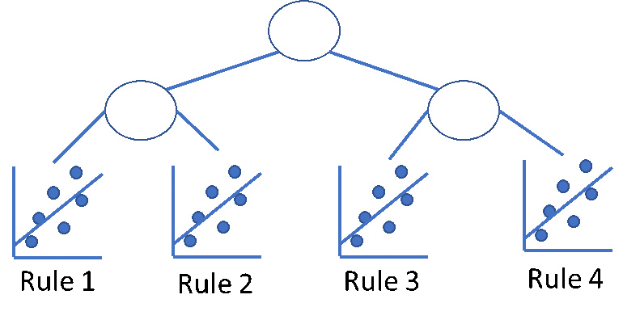
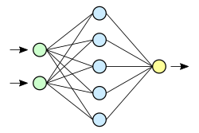
Models
Model Tree
Linear Regression
ANN

Slide 9
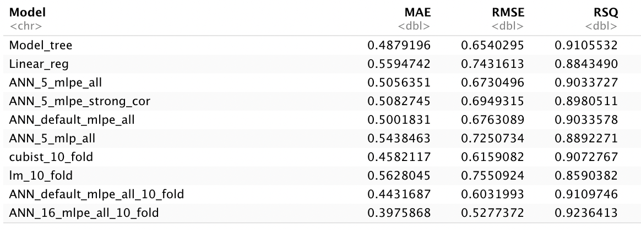
Models performance
set.seed(0)
nn.n16 <- fit(solubility ~ ., train.sample, model='mlpe’, size = 16, decay = 0.1, maxit = 500)
nn.pred <- predict(nn.n16, test.sample)
Overall_Error <- Overall_Error %>%
type_convert() %>%
add_row( Model = "ANN_16_mlpe_all_10_fold",
MAE = MAE(nn.pred, test.sample$solubility),
RMSE = RMSE(nn.pred, test.sample$solubility),
RSQ = RSQ(nn.pred, test.sample$solubility))
Overall_Error

Slide 10
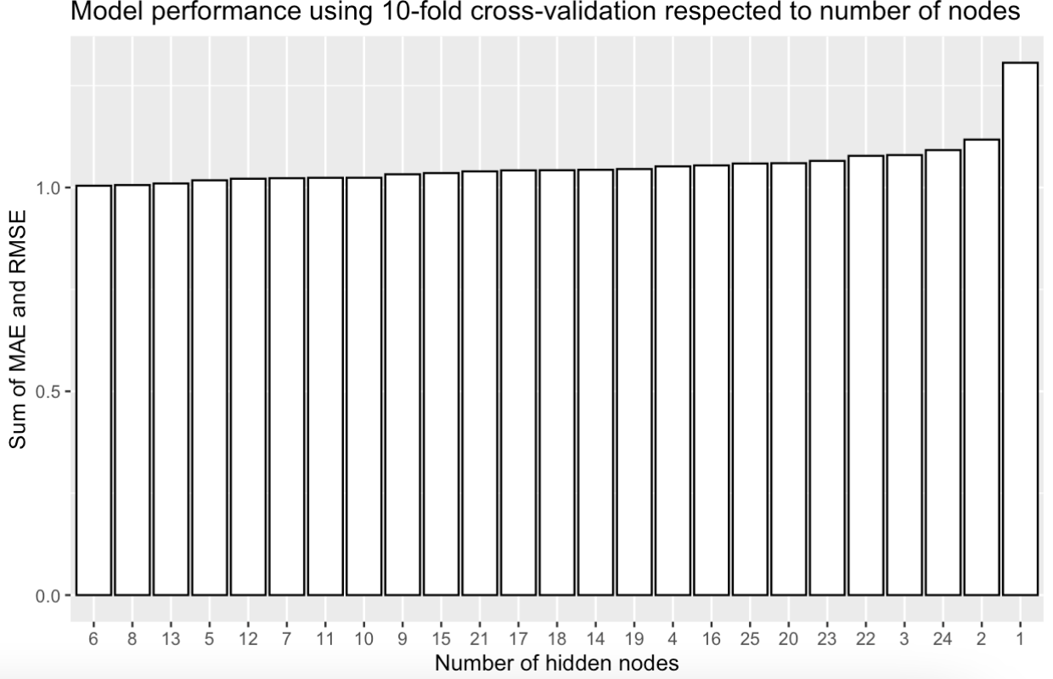
10-Fold Cross Validation + Hyperparameter Tuning (ANN)
set.seed(0)
k = 10 # For k fold
n = 25 # For number of nodes
kfold_hyper_result <- tibble("Fold" = numeric(), "Nodes"=numeric(), MAE = numeric(),
RMSE = numeric(), RSQ = numeric(), "Resample" = character())
k_groups <- sample(1:10, size=nrow(df_clean_no_out), replace=TRUE, prob=rep(.1,10))
for(i in 1:k){
train.sample.idx <- seq(1,nrow(df_clean_no_out))[ k_groups != i]
train.sample <- df_clean_no_out[train.sample.idx, -c(1,2,3)] %>% as.data.frame()
test.sample <- df_clean_no_out[-train.sample.idx, -c(1,2,3)] %>% as.data.frame()
hyper_tune <- tibble("Nodes"=numeric(), "MAE"=numeric(), "RMSE"=numeric())
for(j in 1:n){
nn <- fit(solubility ~ ., train.sample, model='mlpe', size = j, decay = .1, maxit = 500)
nn.pred <- predict(nn, test.sample)
maei <- MAE(nn.pred, test.sample$solubility)
RMSEi <- RMSE(nn.pred, test.sample$solubility)
RSQi <- RSQ(nn.pred, test.sample$solubility)
kfold_hyper_result <- add_row(kfold_hyper_result,
Fold = i, Nodes=j, MAE=maei, RMSE=RMSEi,
RSQ=RSQi, Resample = paste0("fold",i))
}
}

Slide 11
Bagging Ensemble
Caret – ANN/CTree with bagging
ctreebag_rst <- bag(train.sample[-15], train.sample$solubility, B = 20,
bagControl = bagControl(fit = ctreeBag$fit,
predict = ctreeBag$pred,
aggregate = ctreeBag$aggregate))
nnetbag_rst <- bag(train.sample[-15], train.sample$solubility, B = 10, size = 16,
bagControl = bagControl(fit = nnetBag$fit,
predict = nnetBag$pred,
aggregate = nnetBag$aggregate))

Slide 12
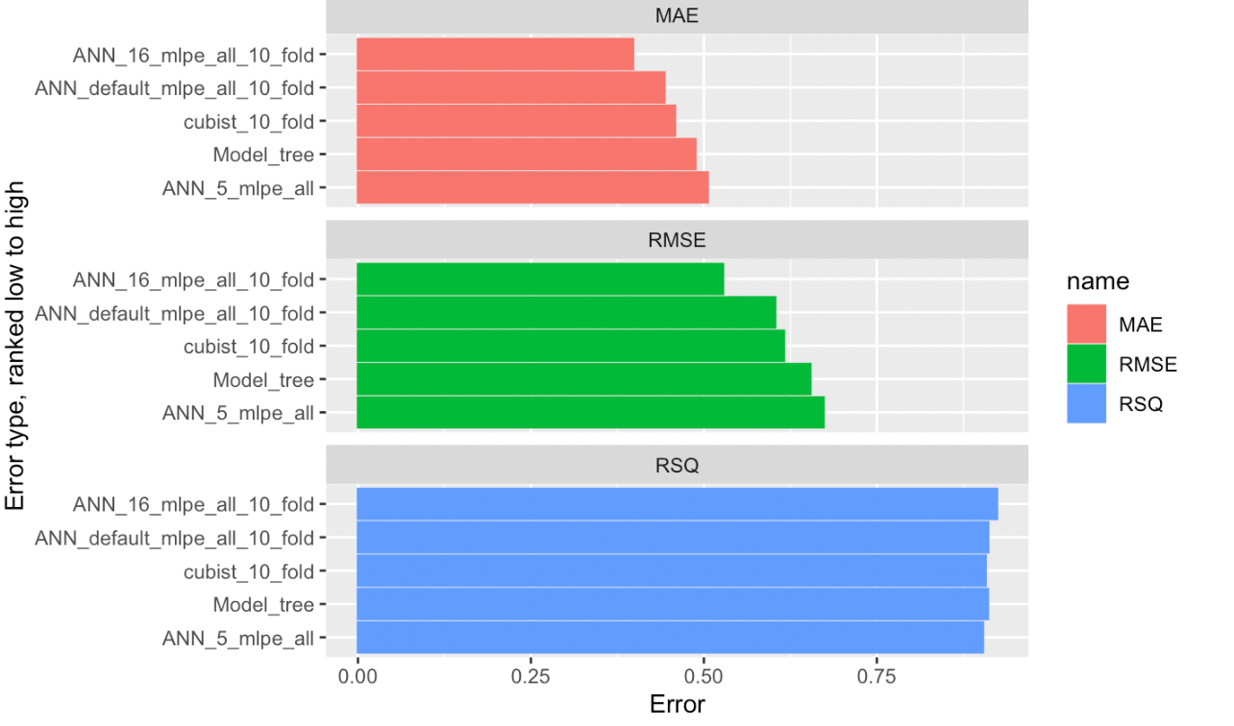
Top 5 Models

Slide 13
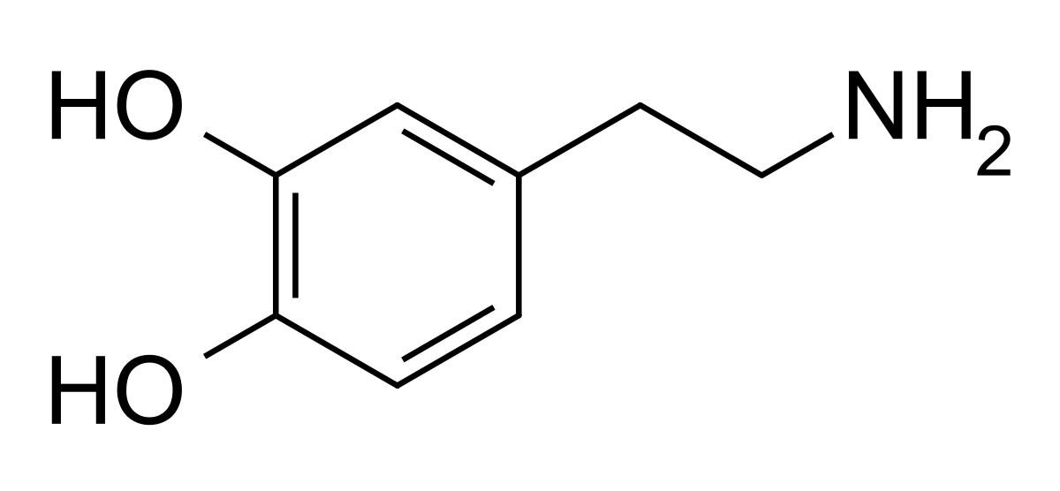
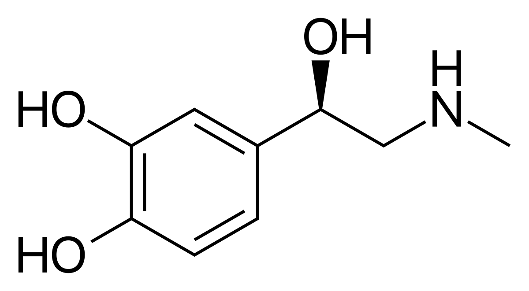
Prediction for Dopamine and Adrenaline.
Dopamine:
Experiment: 600g/L,
ANN bagging: 2719.90 /L,
ANN 16 nodes: 0.64 g/L,
ANN 6 nodes: 0.0030 g/L,
Model Tree: 3801.44 g/L.
Adrenaline:
Experiment: 0.18g/L,
ANN bagging: 118.12 /L.
ANN 16 nodes: 22.31 g/L,
ANN 6 nodes: 9.89e-05 g/L,
Model Tree: 643.41 g/L.

Slide 14
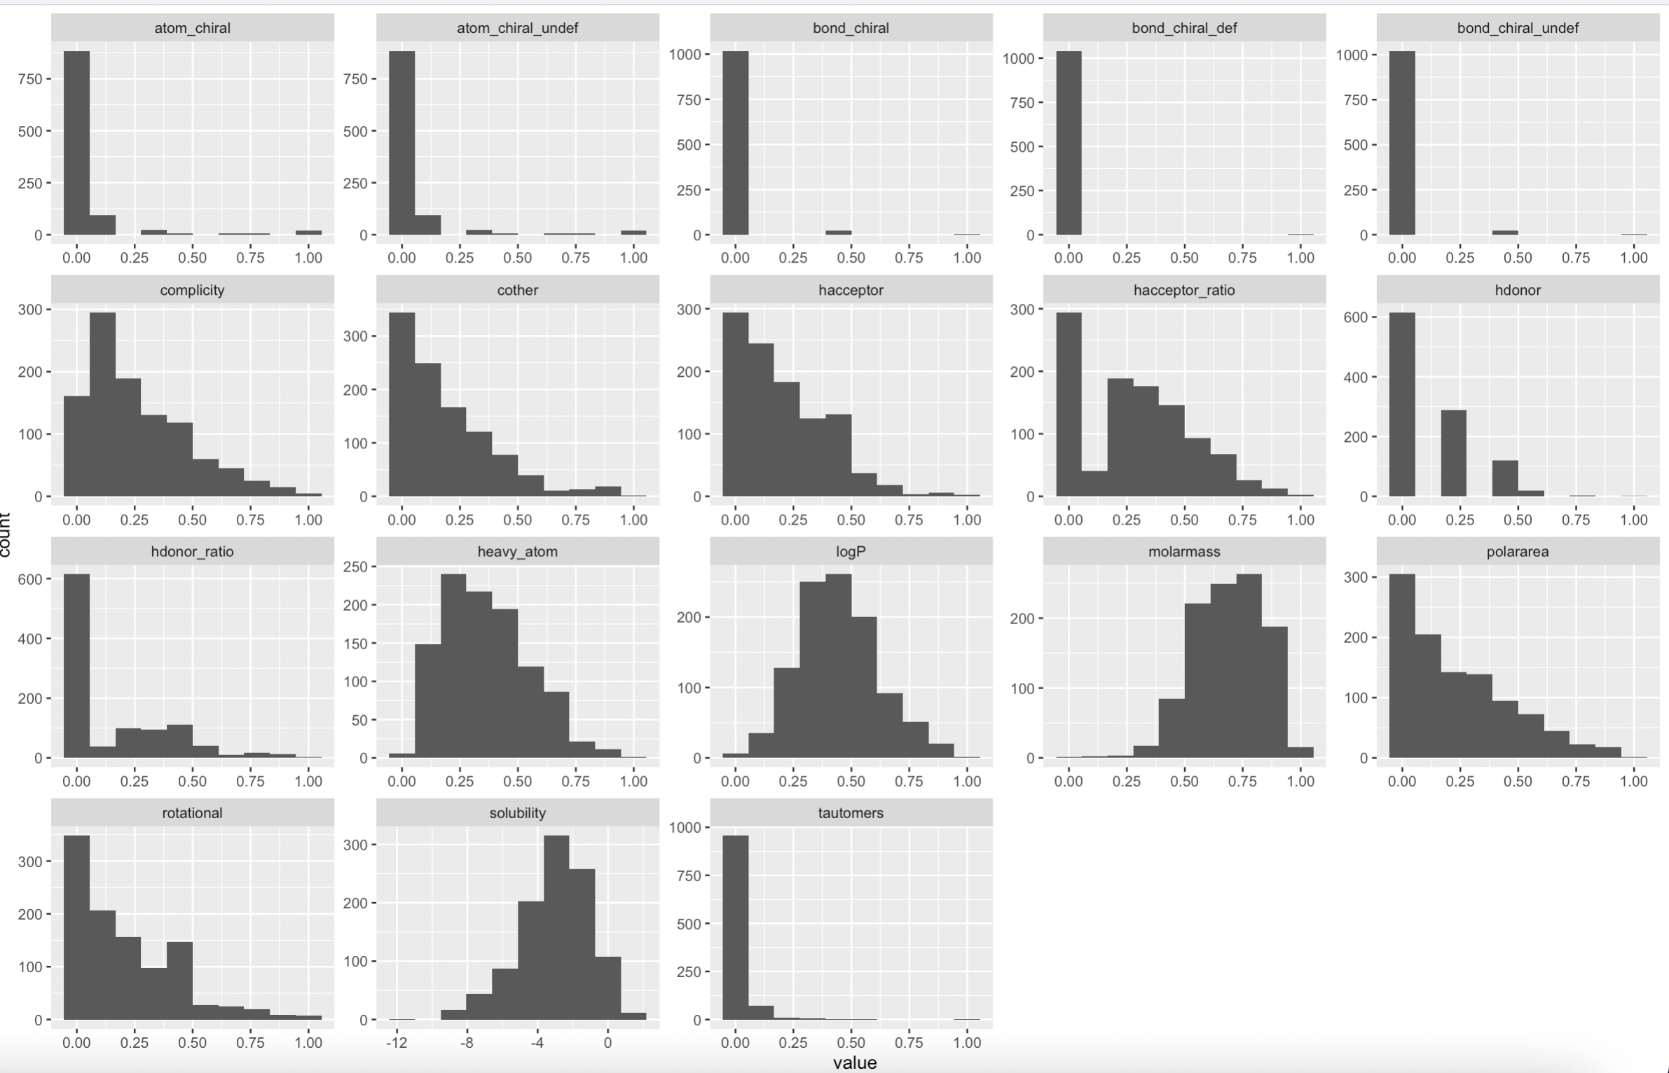
Rescale and Feature Engineering

Slide 15
Lessons Learned
MAE and RMSE decreased to 0.39, 0.52 compared to 0.69, 0.91 from literature.
Model tree and ANN both perform good on testing sample.
Feature engineering improved model performance
Data preparation and feature engineering is really important.
Garbage in, garbage out.
Large error on Dopamine and Adrenaline solubility prediction.
Large variance could caused by overfitting, missing fatures, small training size.

